Slide 1
ePAD workbook activities
Melanie Robbins
m.a.robbins@leeds.ac.uk
Adapted from Tony Chambers:
University of Hull

Slide 2
Do you know how to access PebblePad?
PebblePad is a web based programme that provide a workspace for collecting evidence towards a goal
In this case the electronic Practice Assessment Document or ePAD
This is a really quick link to find out about PebblePad in a nutshell.
https://www.youtube.com/watch?v=25Bf1xIYvBU
Notes:
Ask the students to

Slide 3
Terminology and symbols
Burger menu – drop down of actions/tabs
To go back to your home page you can click on Logo or on the green man
Tabs indicating content within the tab
Students need to click ‘Edit this asset’ here before you can add new information to the ePAD
Atlas, the blue world symbol– the area for assessment accessed by mentor and tutors – students cannot open this area

Slide 4
How to use your e-PAD workbook
Today you are going to complete some
activities to get you started with your workbook
Completing these activities will enable your workbook
to be viewed for assessment by your mentor
It will let you become more familiar with the workbook
It will make you start thinking about ePAD as your own personal & professional portfolio

Slide 5
activities for today:
Check you have been able to open your ePAD and save to your asset store
Briefly Review the tabs and set up (a separate session will look at these in more detail)
Create an attendance sheet
Download Pebble Pocket and use the West Yorkshire and Humber ePAD forms
Attach evidence to your attendance sheet
How to share your ePAD with your mentor(s) for assessment
Feedback
Create your ‘about me’ page
Log out

Slide 6
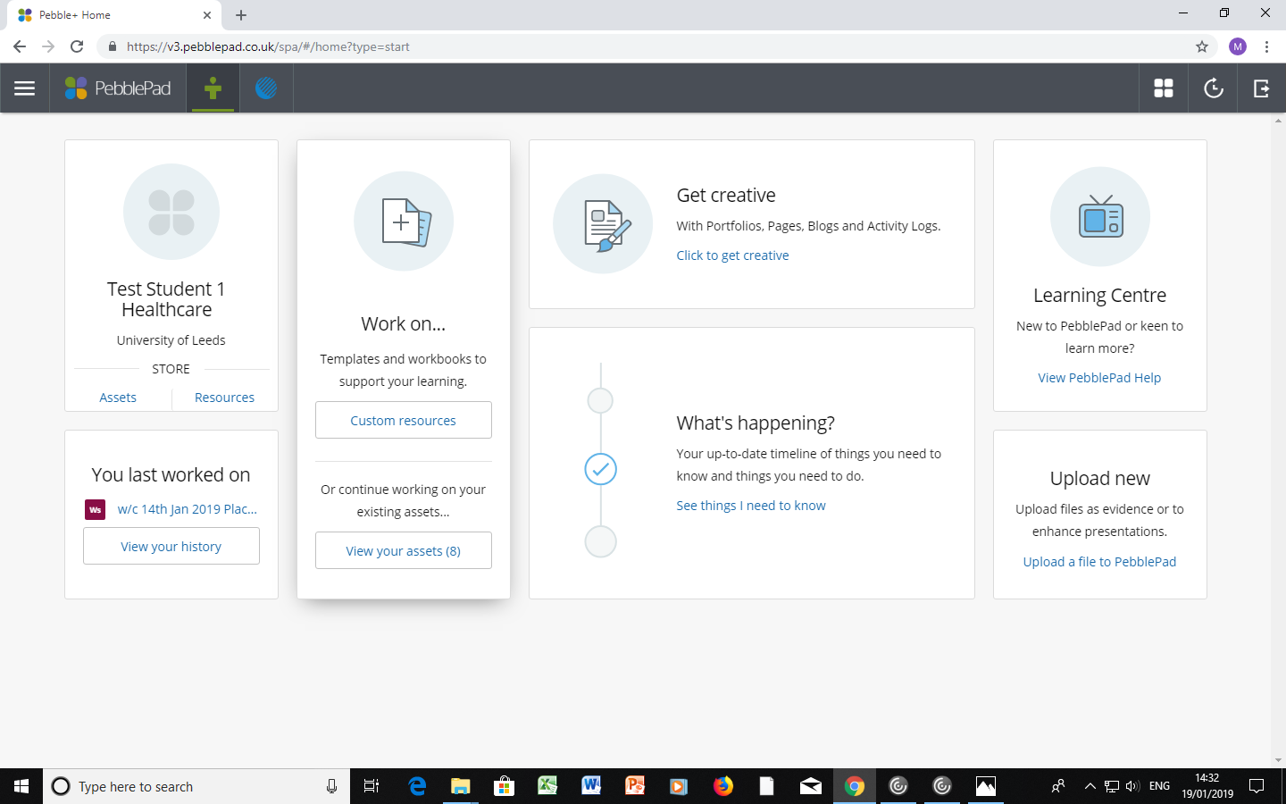
ePAD –
Please do this step by step with me, do not rush a head!
Go to PebblePad web site and insert www.v3.pebblepad.co.uk/login/leeds
User ID – your university email e.g. hc18xx@leeds.ac.uk
Password – your unique password , if you have not changed the PebblePad generated one within your email, please change now.
Your home page and click on assets and open your ePAD

Slide 7
ePAD
The ePAD is where your practice standards are now kept.
The ePAD has the same areas to complete as the previous paper version
Placement details (area, mentor name, mentor updates)
Placement orientation – health and safety, safeguarding policies etc
Initial interview
Intermediate interview
Final interview
Practice standards
Skills log
Attendance and absence
Testimonials
Let’s have a look at these in a little more detail (NB you have another session looking at the forms in more detail)

Slide 8
ePAD
Review ePAD tabs
A more detailed look at these will be undertaken either
Discussed in class or
Through the video on PPU web site
Essentially the ePAD enable you to state ;
Where your experience was undertaken and who was assessing you (PAD Form details)
That you are orientated to the area (know where everything is and key information such as the emergency equipment and phone number)
Agree your learning needs (initial interview)
Review your progress and adjusted your learning (Intermediate interview)
Review how the whole placement went (final interview)
Sign off NMC required standards (Practice standards and Medicine standards)
Sign off accompanying skills (Skills Log)
Record the client/patient view of your work (testimonies)

Slide 9
How do I do this
Work with your NMC mentor (Your NMC mentor must be in date that means they have undertaken an annual update and a 3 yearly review of NMC Mentoring standards
They will sign off Practice standards, medicine standards and skills by
Working directly with you and/or
Reviewing contributing evidence which can be – drawn fro working with others e.g. Associate mentor (RN without an NMC mentor course) other Healthcare professionals – this evidence must be verified via
Pebble pocket – completed form evidence of hours or offline assessment
Completion of a Record of Alternative/complimentary/spoke placement form (long name because it has to fit 5 Universities across Yorkshire)
Photo’s of work undertaken in class
Essays
Certificates of study days or eLearnign packages
Uploaded to your asset and attached to the relevant rosette

Slide 10
ePAD
Remember this is a record of your progression and achievement and must be treated just as importantly as any other record – e.g patient care plan or medication chart
It is one way to demonstrate you are proficient at record keeping.
It is your responsibility to ensure these are completed fully and contemporaneously (in a timely manner).
External examiners and NMC monitors can request to see your practice records
Failure to complete all of the ePAD for each placement by the submission date, will result in a fail for documentation and your module mark will be capped at 40
Look out for the drop in sessions – anyone can attend, student or mentor to ask questions, or to go through an aspect of the ePAD – you only attend for the period you need to answer your question i.e you don’t have to stay for the full hour
You must ensure that you plan any NMC mentor annual leave within your timeframe for completing your work – this is not an emergency or reason for extension
Save, save and save as you go through and before you leave a page

Slide 11
How to add files to My ePAD

Slide 12
Adding files to my ePAD
You can add files to your ePAD a number of ways, here are some examples;
Creating an asset using the Yorkshire and the Humber Pebble Pocket forms in Pebble Pocket
once completed and saved to your device, these are downloaded directly into your asset store to then link to a rosette
Completing a paper form (e.g Record of experience/Spoke placement form or a written reflection)
These need to be saved to your ‘M Drive’ then uploaded to your asset store to then link to a rosette
Saving a certificate e.g. from an electronic learning package or scanning in a paper certificate
These need to be saved to your ‘M Drive’ then uploaded to your asset store to then link to a rosette
You can add different types of files such as an image, or written work

Slide 13
Formats ePAD will accept and allow others to access
Whilst you can upload a variety of file types, not all of these are supported by PebblePAD and so your intended users will not be able to open
Please use the following formats;
Word document that is in word, on a computer drive (use the university M drive and not onedrive or cloud based or document sharing services)
“iOS Apple Device users (eg iPhone, Mac) please note that HEIC image files and webarchive files are NOT compatible with PebblePad. We are unable to open and view these file types if uploaded to your ePAD. Please convert image files to a .JPEG and .webarchive files to a PDF before uploading to PebblePad.
Further details on how to change your iOS settings or how to convert HEIC files are available on the Apple Support webpages here: https://support.apple.com/en-us/HT207022 ”
There is additional information on PebblePad supported files at http://practiceplacements.leeds.ac.uk/wp-content/uploads/sites/27/2019/12/PebblePad_Supported_file_types.pdf

Slide 14
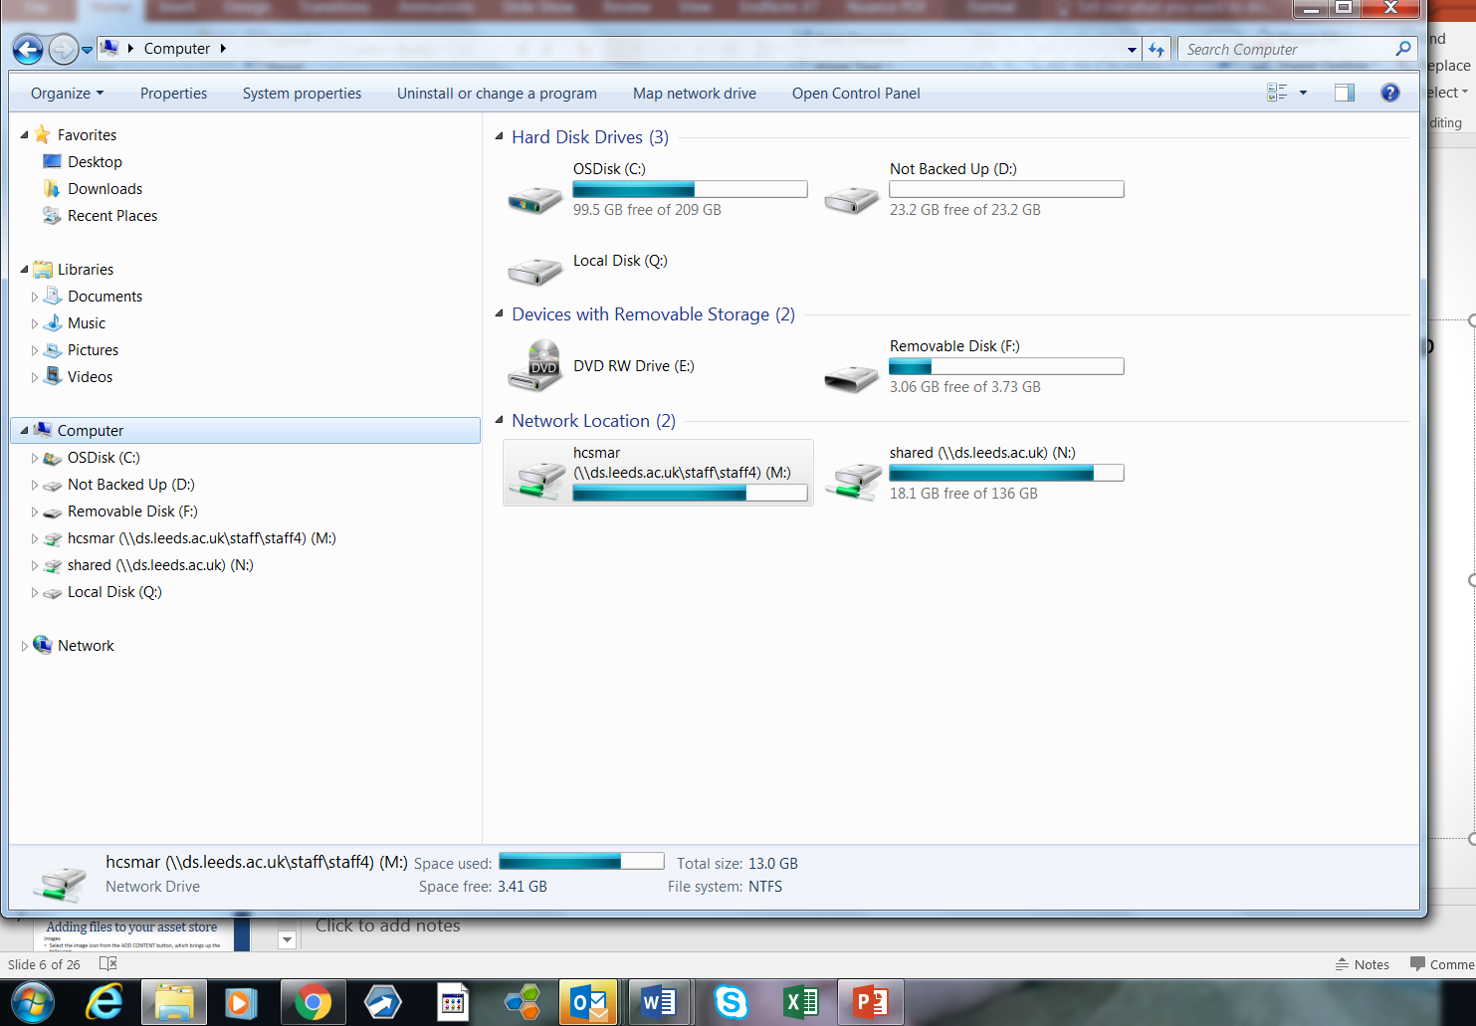
Where is my M drive?
M drive is the university space saved for you. It is backed up everyday so you
do not have to worry about losing information, essays etc.
You can save to your M drive by sending your work as an attachment to your
University email, then save to M drive from a campus computer or use Desktop Anywhere
using the file manager you can save
to a particular area on m drive
You can also use the Desktop Anywhere which provides access to University IT services in a familiar cluster-style desktop from anywhere with a stable Internet connection. https://leeds.service-now.com/it?id=kb_article&number=KB0011015

Slide 15
Where is my M drive?
Another way to access your
M drive
Click on the start button
Pop up menu choose the windows explorer

Slide 16
Where is my M drive?
This is your M drive – you can tell
by the location strip
You will see some files already in existence – these are to do with university computer programmes – so do not adjust.
You can then add files yourself and save to those files e.g I have created a file for ePAD reports . When you click on it, you can see the reports saved to the file
The location strip tells you where
you are

Slide 17
Let’s create a file
You were sent an email from Zoe Gilchrist with the subject
‘201920 PROG BS Nursing (Adult) UG (Year 1): PebblePad (ePAD Tool) - please read this (Action Required
Locate this email
Open the attached powerpoint (PP) presentation
Save the PP presentation to your M drive by
clicking on the
File tab (top left) then in the drop down menu
select ‘save’ or ‘save as’ Or right click and the
same menu will appear
You now need to make sure you are in M drive
(click on the computer to open your drives,
click on M drive which will open your M files),
otherwise it will save to the computer you are
working on.
Chose where you want to save the email to and what title to give it.
You have now saved a file to your M drive.
(we will attach this to a rosette later on)

Slide 18
Uploading files
There are lots of places to start uploading files from...
1. Pebble+ Home
You will find the 'upload new' panel on the Pebble+ home page.
(Bottom right of screen)
This opens the file upload tool as a new page.
2. Burger menu
This can be found in the top left corner throughout PebblePad. Open the burger menu and you will see the 'Upload a file' option. This opens the file upload tool in a small pop up window that overlays the page you are on, so you don't have to stop what you are doing and go to another page just to upload a file.
Click here to show the
drop down menu
Click here to open the upload
function

Slide 19
Uploading files
3. Store - Assets tab
When viewing the assets in your Store, you can find an 'Upload' button in the top right of the page next to 'advanced search'.
Selecting files to upload
The upload tool provides you with two easy ways to select files for upload. You can browse for files in your file manager (e.g. Windows/File Explorer, or Finder in Mac) and simply drag and drop them on the 'Drag a file here' area (this option is not available on touch devices). Alternatively, clicking 'Or choose a file...' will open up a file manager window for you to browse and select the files you would like to upload.

Slide 20
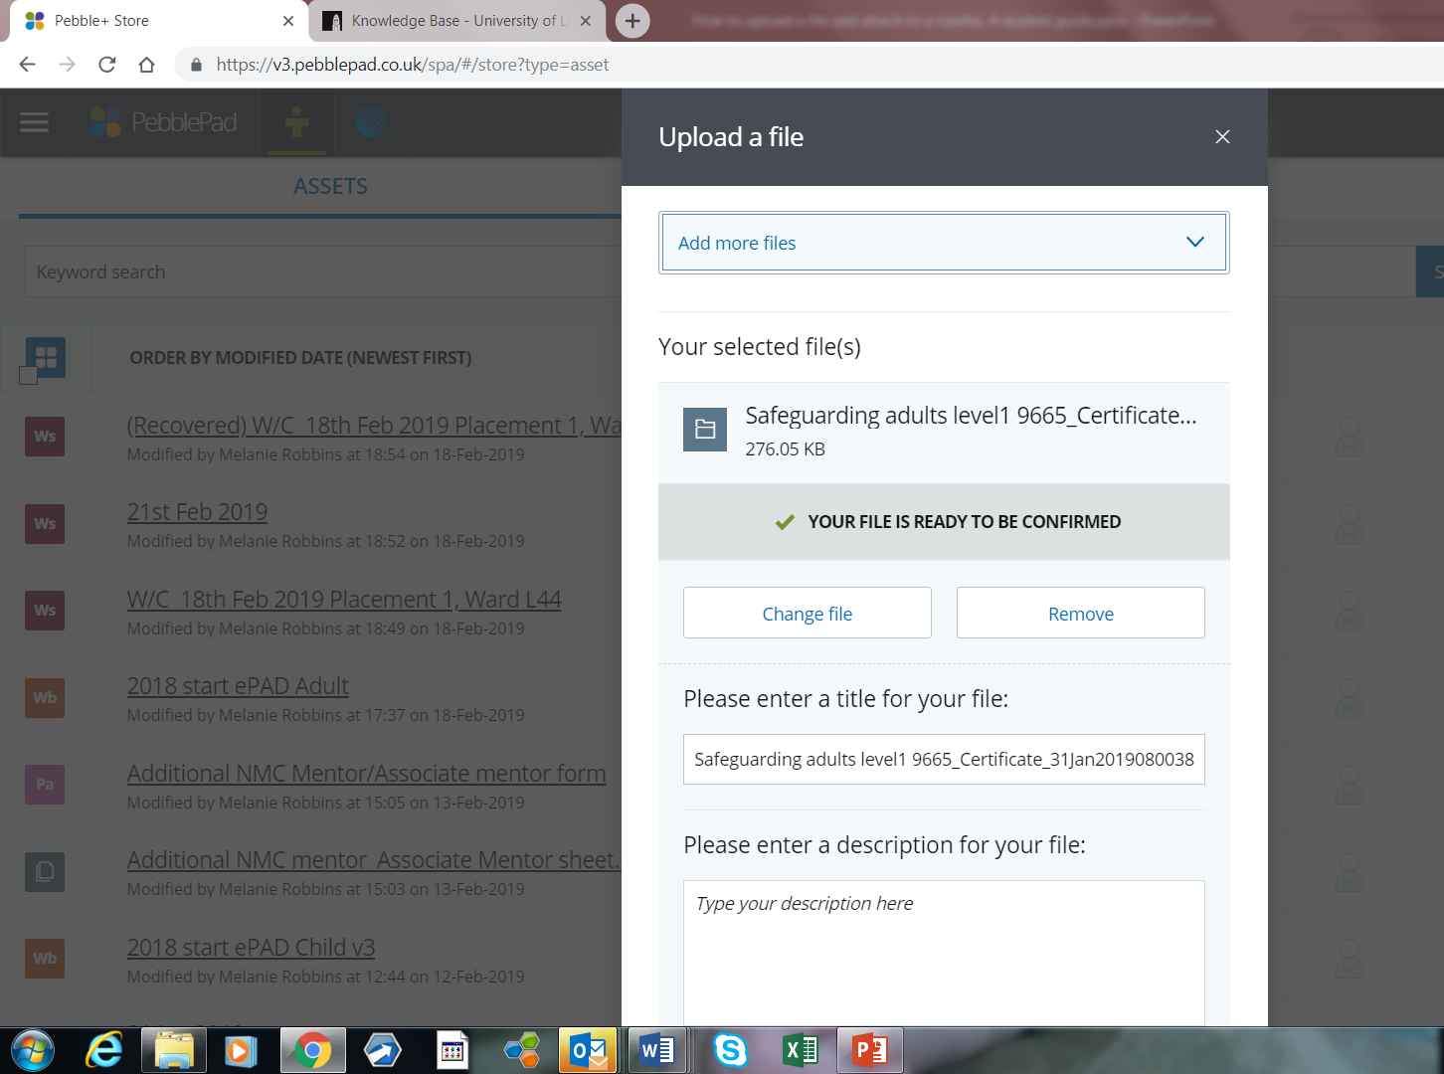
Uploading files
To add from M drive, click ‘add a file’ and your M drive will then open, navigate to the file you wish to upload and click
You will see the file chosen
The opportunity to change or
remove
The opportunity to rename
The file
Scroll down and click
Confirm upload button

Slide 21
Linking an upload file to a rosette to provide evidence towards a standard
Your rosettes are linked with the Tabs where additional forms or evidence can be added for example your
PAD forms,
attendance sheets,
practice standards,
skills,
testimonies and
Alternative Field Experiences.
Choose the tab and the rosette your file provides evidence for.
Click on the rosette
A drop down menu appears
Click add asset

Slide 22
Your PowerPoint slides – let’s now attach them to a standard
Remember we saved the PP slides earlier
we will now us this as evidence towards this toward a standard in the care and compassion domain
Standard 1a Articulates and adopts a principled approach to care and works within the Code (NMC 2015) and adheres to the Guidance on professional conduct for Nursing and Midwifery Students
This is because handling data correctly complies with NMC (2018) The Code section 10 and 13.
https://www.nmc.org.uk/standards/code/
Click on the rosette for this standard

Slide 23
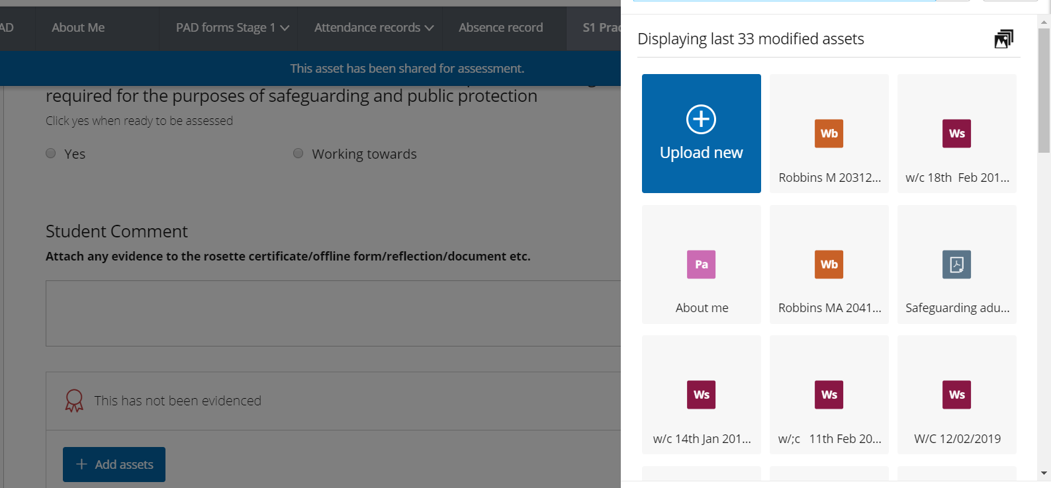
Linking an uploaded file to a rosette
A pop up menu appears on the right hand side of the screen with all of your assets. Chose the asset you want to link to the rosette
A green tick appears in the top left of the asset
(sometimes ePAD will do this for you
if you go directly from uploading a file
to adding to a rosette). You can add more
than on file. Click done

Slide 24
Linking an upload file to a rosette
The rosette is now yellow in colour with a tick in it and the linked file is shown below the rosette
You will have noted the Justify box – this is where you can add addition information or an explanation as to how this meets the standard of guidance for your mentor to locate specific information with in large document e.g an essay, so if the bit on p5 para 4 meets the standard , indicate this so your mentor doesn't’ have to read the whole essay!

Slide 25
Let’s provide evidence for another standard
In preparation for this session you were asked to save your Information Governance certificate (data security/data protection) ePackage you did on eLearning for Health.
You should have saved this to your M drive (note of caution if you did this at home you may have saved it to your home computer!)
If you haven't done this yet, you need to do this now.
Once competed.
Open you ePAD, go to S1 Practice standards – opens a drop down menu
Click on the Care and Compassion tab
Scroll down to standard 7a
Click on the rosette and upload your certificate to the rosette.
You can also download you safeguarding certificate for the ePackage (Safeguarding vulnerable people Key lecture) and load those to Care and compassion domain, standard 7b.

Slide 26
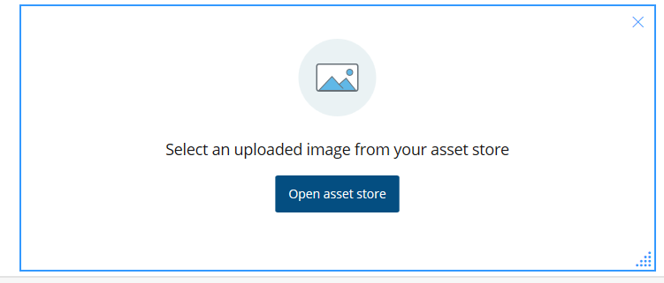
Adding files to your asset store
Images
Select the image icon from the ADD CONTENT button, which brings up the following:
You must ensure any image uploaded doesn’t have copyright. You MUST NOT upload any images of patients, people or confidential documents, even if you are given permission ,as this breaches the trust governance policy.
Press the open asset store button. This opens up your assets on the right hand side of the screen. Select the ‘would you like to upload?’ option
Then the ‘Or choose a file’ button
Look on your PC for the image you want to use, once you have found the picture select it by double clicking on it. The picture will now appear in the right hand side of the screen; if you’re happy with it press the confirm upload button at the bottom of the box (may need to scroll down)

Slide 27
Photo’s (nb. for word doc it is better to scan the documents)

Slide 28
Assets
You will soon find that your ‘Asset’ store grows as you progress through the programme.
This is expected due to the amount of evidence you will be collecting, writing and uploading to your ePAD.
Do not delete any assets to create space as this will remove it from wherever it is linked to in ePAD.
However, for ease, the asset store will display your most recent files first.

Slide 29
How to create an attendance (or Absence) form

Slide 30
How to: complete an attendance (or absence) template
First of all make sure that the search criteria is turned ON:
To enable this page to work please click accept criteria, then when you save your attendance sheets they will automatically appear here and your target hours will accumulate over the stages of your course.

Slide 31
How to: complete an attendance (or absence) template
Go to the resources store (it is not yet personalised) Make sure you open the ATTENDANCE form and not the absence form
Complete an attendance template for each week you are in placement. You will find this in your resource centre.
Complete the template as per the instructions remembering to save it as w/c --/--/---- Placement and ward
E.g
W/C 14th Jan 2019 Placement 1 (or P1) L40
Your mentor will check this weekly and confirm the total hours for the week and this is then locked for monitoring by the administration team

Slide 32
How to: complete an attendance (or absence) template

Slide 33
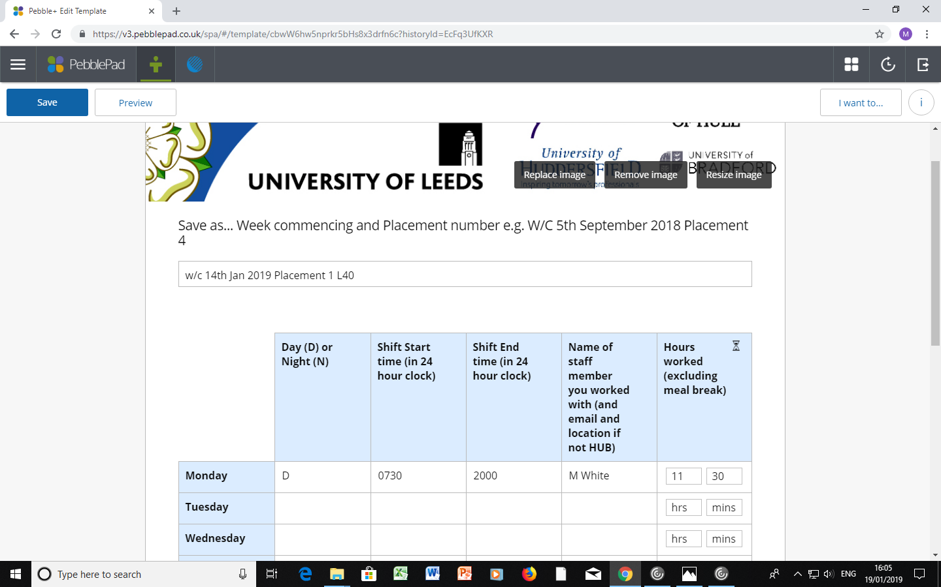
How to: complete an attendance (or absence) template
Title who you worked with and email
address if not hub
Start time
End time
total hours for the shift (minus breaks)

Slide 34
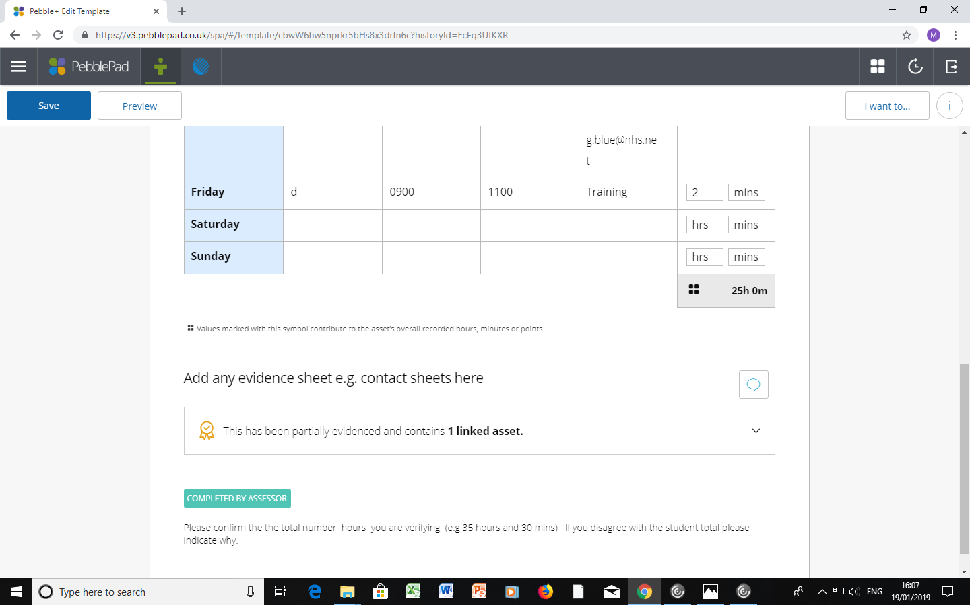
How to: complete an attendance (or absence) template
This has
One
Linked
Asset
As
Verification
Of hours
claimed
Your mentor confirms here
The final total is auto addition (Pebble Pad does it for you )

Slide 35
How to: complete an attendance (or absence) template
Now go to your ePAD
Open the attendance tag and correct placement sub tab
Click the search button to ‘on’ (if not already done so)
Your attendance sheet should now appear.
You will need to switch the search button for the correct placement tab when you start you next placement
Follow the same process for an absence sheet (NB only one tab for absence so all you absence forms are shown in this tab

Slide 36
How to complete an Absence form
Exactly as for an attendance form except
You use an absence form ! So let’s do it
In your resource store find the Absence form, complete it as
W/C (this week) Test absence form
Complete it as 1 hours absence on today’s date and save
You need to go to the Absence tab and
Click the search button to ‘on’ (if not already done so)
Your absence sheet should now appear (don’t worry we will deduce this test for your absence total) .
You must complete a weekly absence form for any week you have an absence DO NOT PUT ABSENCE HOURS ON YOUR ATTENDANCE SHEET
There is only one absence tab which will list all of your placement absences for the whole programme

Slide 37
Important things to remember!
Your mentor can only verify hours that you can provide evidence for. Use the available pdf and electronic templates for recording hours and experiences when you are doing additional visits.
Your mentor verification must match your total.
Your mentor verification MUST be after your table is complete. Your mentor may allow additional time for you to ensure the weekly table is correct before they will verify it.
You must NOT under any circumstances change the table once your mentor has verified it. Your mentor and the University will be able to see this and this can lead to severe consequences.

Slide 38
Hints & tips
Use the electronic app forms in pebblepocket – this makes uploading and presenting evidence to your mentor easier.
If you want to write and upload a reflection – use the create your own pages in Custom resources in your own PebblePad.
If you upload evidence from paper – take a scan or photo of the page and upload it as image and save it in your app assets . This makes it easier to attach it in ePAD later. Scan is preferred (cleared) but please make sure the photo is taken a an overhead image not from the bottom.
Or you can scan it into your computer and save as a file to upload to ePAD. This is the best way and it will display the full contents of the evidence clearly.
Always LOG OUT once you have finished working on your ePAD to
Prevent multiple versions being created (if you log in again or on a different PC)
Maintain data protection (esp. important if using a public PC)

Slide 39
How to share your EPAD with your NMC mentor

Slide 40
How to share your ePAD with your mentor(s)
After you’ve got and saved your ePAD from your PebblePad Resources, your personal copy becomes one of your Assets.
Every time you save, the changes are reflected in the atlas (assessing) side of PebblePad, you do not have to SUBMIT your ePAD for assessment
You’ll keep working on it for the whole of your degree. Your mentor(s) will need to see it and tick off certain parts within it to verify that you are progressing appropriately. You need to share it with them to allow this.
Here’s how:

Slide 41
How to share your ePAD with your mentor(s)
Go to your asset store and locate your ePAD, click on the ‘I’ button (far right)
this opens a pop up tab
Click on the ‘I want to’ button

Slide 42
How to share with my Mentor
Click on the ‘Share’ icon
Choose
Type your mentor’s work email address into the box and click the search button to find them.
Note: you must type their exact work email, do not add capitals if no capitals in the email address. Check with your mentor if you’re unsure!

Slide 43
Once you’ve found them, scroll down and click the Share asset button.
before you start your next placement you need to delete this share (otherwise your mentor will have permanent access to your ePAD). NB it is recommended you do not do this until your ePAD has been marked and passed by the academic linked to that placement (Personal tutor/module tutor)
delete the share by using the property / information panel in the store or on the asset
Press the bin icon

Slide 44
Some common issues
If you can’t find your mentor on the system, first double-check their email!
Remember they may be more than one John Smith in the organisation, it must be exact, check spelling, it is smith or smyth? no erroneous capitals
Always make sure you are sharing at ePAD level not asset level.
You mentor must be using the University of Leeds log in and not LBU
If they’re definitely not there, or you are having problems, contact PPU using epad@leeds.ac.uk and provide the following details: your mentor’s first name, last name, and work email.

Slide 45
Feedback

Slide 46
Feedback in ePAD
ePAD is live
That means your mentor and tutor can give feedback at any time
Once assessor contributions to your ePAD have been saved you will
receive an email from
pebble pad (not your
mentor or tutor)
The email will indicate what type of feedback – Assessor field or Feedback
Click on the link in the email and tit will take you to your feedback.

Slide 47
Assessor Feedback in ePAD
When the email indicates Assessor feedback
Follow the link to the assessor feedback
Your mentor will receive a similar email when you complete a section and save.

Slide 48
Feedback in ePAD
When the email indicates feedback , this can be from a mentor or more likely a tutor. The tutor will have added comments and may have attached a file for you to read
Click on the ‘I’
In the drop down menu click Feedback and you will see the feedback added to the page/ePAD
When you click on the
attachment – the file will open.
You can respond by clicking the reply button.

Slide 49
Feedback in ePAD
NB
Please remember to check your spam/junk box and if the emails are directed to there, re set your parameters to accept emails from Pebble Pad.
ePAd@leeds.ac.uk can help

Slide 50
How to create the ’About me; PAGE

Slide 51
Why complete the ‘about me’ page?
Creating this page will help you find your way around PebblePad and familiarise yourself with the tools.
This is your opportunity to introduce yourself professionally to your mentors and tutors.
Creating the about me page will start the development of your professional portfolio which you can take with you after the programme and use for CPD and revalidation.
You can use multiple media to bring together a page with a lively visual format
But remember:
Maintain professionalism
Remember who is viewing your work
Maintain confidentiality
Familiarise yourself with the NMC Code in relation to the above

Slide 52
Banners
You may leave the Pebble banner as it is or if you wish replace with one of the images PebblePad provide (recommended)
Or you may use one of your own photos. Make sure you do not breach copyright, privacy or professionalism with your picture. Or you can leave it as it is
On the banner you must insert the following:
your name, student ID number, cohort and field of nursing; for example:
You can edit your Banner
Clicking on the properties
Tab (top right and side
of screen)

Slide 53
Add Content
Once you have finished your banner you can use the 'add content' button to insert a text box, image or other item:
Selecting the ADD CONTENT button will bring up an additional menu to allow you to select a range of files and media to personalise the page:

Slide 54
Add Content: Text
Once you have finished your banner, select the 'add content' button to insert a text box.
This allows you to write a little bit about yourself and your journey to becoming a nurse
In creating a professional portfolio you might want to consider the following questions
Why did you want to be a nurse?
What skills do you bring to the course and how will they help you interact with service users and carers?
Do you have any hobbies and skills that will help with your role?
As you progress through the programme you may want to re visit your about me page and up date the information, perhaps reflecting on the previous stage and consider what you want to achieve in the next stage

Slide 55
Add Content (Upload image)
Using the add content button, add an image box and upload a professional photo of yourself
You will have to upload images to your asset store from your PC first
You can take a ‘selfie’ but please consider what image you want your mentor to see. If you put a picture of you in uniform make sure you conform to uniform policy. If you use an alternative photo think about how others will see you. Make sure you are the only one in the photo (breach of privacy and data protection)
Any image that is unprofessional or offensive will be dealt with formally through School processes

Slide 56
Preview
Preview the page to see how your page will look to the viewer.
Remember to put ePAD back into editing mode after previewing pages:

Slide 57
REMEMBER ……..
Always LOG OUT once you have finished working on your ePAD to
Prevent multiple versions being created (if you log in again or on a different PC)
Maintain data protection (esp. important if using a public PC)

Slide 58
Other Useful informiaotn
Other useful information

Slide 59
ePAD – Practice standards check list
Practice standard check list – you can utilise this to record which standards your NMC mentor has signed off as achieved,
plan on – going learning
opportunities
Suggestion -
Put a dot against the ones
you think you have achieved to discuss
with your mentor and then
a tick once your mentor has signed off
the skill (or you could colour code)

Slide 60
Practice Placements Website
Holds lots of information about your placement
https://practiceplacements.leeds.ac.uk/
Also have lots of guides and video links to help you with your ePAD
https://practiceplacements.leeds.ac.uk/nursing-and-midwifery/information/

Slide 61
Where to go for help - epad@leeds.ac.uk
Please email epad@leeds.ac.uk stating what the issue/question is
PLEASE GIVE DETAILS
We can then direct your email to the correct person – e.g. Healthcare IT or your Personal tutor
State
Who you are,
which field and cohort,
your Personal tutor
who you mentor is and her/his work email address
If it is a issue with a tab/standard/skill – please tell us which tab and which tab/standards/skill
We are not mind readers!

Slide 62
ePAD drop in sessions
These are for you, your mentor or both to drop in with questions or to trouble shoot and problems
You only need to stay for as long as it takes to answer your questions.
The sessions are in 2.30b ( around the side of the PhD suite, it is sign posted)
16th March 12-1pm
17th March 4-5pm
31st March 9-10pm
1st April 12-1pm
20th April 4-5pm
18th May 12.30-1.30pm

Slide 63
Any questions?

